Slide 1

What? → Why? → How?
A project so ridiculous and asinine it’ll make you say “tf?”
By whom: Adam McDaniel, Vicky Chakpuang, Logan Wrinkle

Slide 2
What Did We Make?
We wrote a collection of compilers based on complexity so absurd and unnecessary that it becomes comical.

Slide 3

Stage One: How does it work?
This is Brainfuck, a language designed to be as minimal as possible. It is barely turing complete.
Our overarching compiler takes our high level language, designed to be readable by humans, and writes an equivalent program in this.
For more information on BF, visit https://esolangs.org/wiki/Brainf***

Slide 4
Operations of Our Stage 1 (How) Backend
Symbol | Description
+ | Increment the value at the tape pointer.
- | Decrement the value at the tape pointer.
< | Move the tape pointer left.
> | Move the tape pointer right.
[ | Begin a while loop with the value at the tape pointer as the condition.
] | End the while loop.
Symbol | Description
, | Read a character from STDIN into the tape at the pointer.
. | Print a character to STDOUT from the tape at the pointer.
* | Set the pointer equal to the value at the current cell.
& | Undo a * operation.
? | Allocate a given amount of memory dynamically and store the result in the current cell.
! | Free the pointer at the current cell.

Slide 5
Stage Two: Why?
To compile to Brainfuck effectively, we created an intermediate representation (named Why): a language in between the frontend and backend.
This mediates the difficulty of compiling a high level language all at once.
It implements lower level abstractions, like a stack and heap, for the higher level language to make use of.

Slide 6
Stage Three: What?
Finally, we compile our high level language (named What) to our intermediate representation, which in turn is assembled to Brainfuck.
We enforce a small type system with strict rules, we compile function calls and nested block scopes, and we even allow manual memory management with alloc and free.

Slide 7
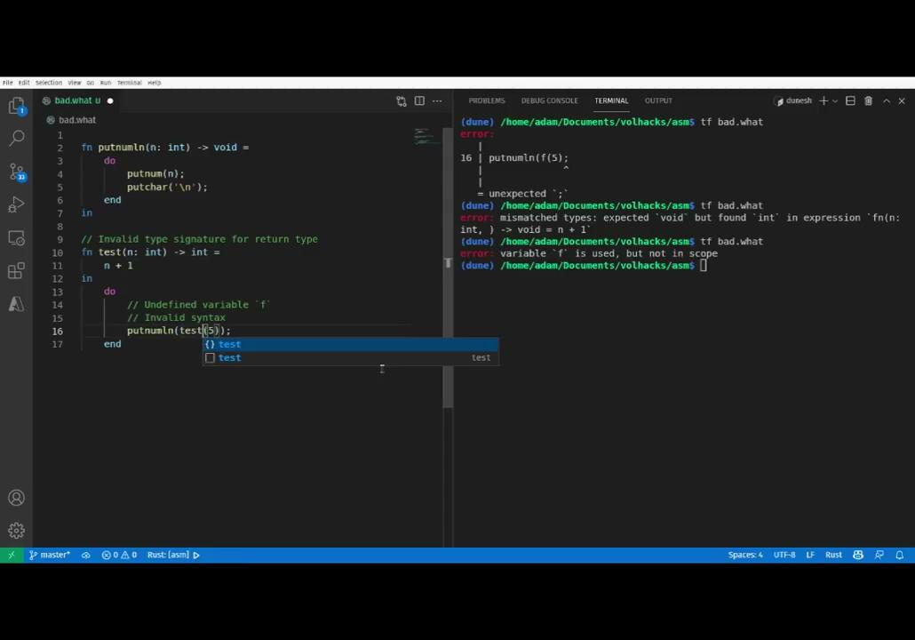
Stage Three: What?
Our error checking is extremely nice for such a short window to implement the project!

Slide 8
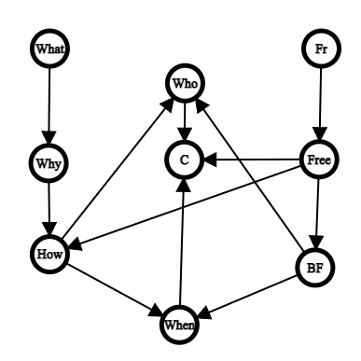
Compiler Collection Overview
In addition to our main compiler for What and Why to How, we also have a few other related compilers in the family.
When is a compiler from both Brainfuck and How to C, which allows us to quickly run our generated code.
Who is a self-hosting, bootstrapped compiler implemented in pure Brainfuck, capable of compiling both Brainfuck and How code.
Free is a very stripped down, untyped language that can compile to pure Brainfuck, which we used to implement Who.

Slide 9
Why Did We Make This?
We were very impressed by the notion of turing completeness, and we wanted to explore its extremes.

Slide 10
What Did We Learn?
All programming languages are fundamentally equivalent: they are merely different implementations of the same thing.

Slide 11
Anything We’d Like the Judges to Consider?
Even though it may look small, keep in mind that this was an extremely difficult accomplishment: a type-checking program that writes other programs. This is a highly involved theoretical Computer Science problem, and we are very satisfied with our results.

Slide 12
Thank you! 👋

